Slide 1
SkyOps
TEAM MEMBERS
Rathneshvaran.I
Airline Reservation & Flight Operations Management System
25WU0101105
Lohit Sitharth.V.O
25WU0101066
Sanjay.K
Design and Implementation of a Relational Database Management System
25WU0101122
CLASS CSE RHINOS
COURSE DBMS
MySQL + Web UI
Notes:
Problem description, ~1 min: title, problem, objectives, scope, users.

Slide 2
A · PROBLEM DESCRIPTION · ~1 MIN
Why This System?
The problem Airline operations involve many connected records. Without a structured database, duplicated or inconsistent data leads to booking conflicts, incorrect manifests, invalid check-ins and unreliable reports.
OBJECTIVES
INTENDED USERS
01
Design a normalized relational database
02
Maintain data integrity across operations
Airline administrators
03
Prevent duplicate / invalid bookings
04
Support flight search and reservation
Reservation staff
Check-in staff
05
Manage passengers, tickets, check-ins, baggage
06
Process cancellations and payments
Operations staff
07
Generate operational reports
08
Connect the database to a working frontend
Passengers
Scope: airports, routes, aircraft, seats, flights, passengers, bookings, tickets, check-in, baggage, cancellations, fares, payments.

Slide 3
A · SCOPE & ARCHITECTURE
From Reservation to Flight Operation
FLIGHT
SETUP
Airport
Route
Flight
Aircraft
Seat
RESERVATION
& PAYMENT
Fare → Booking, Payment
Cancellation
Booking
Passenger
Fare
Payment
AIRPORT
OPERATIONS
Related entities link reservation activity with flight operations: every check-in and baggage record traces back to a ticket, booking and flight.
Ticket
Check-in
Baggage
Notes:
Walk top to bottom: infrastructure, reservation, operations. Booking to Cancellation, Fare to Booking/Payment.

Slide 4
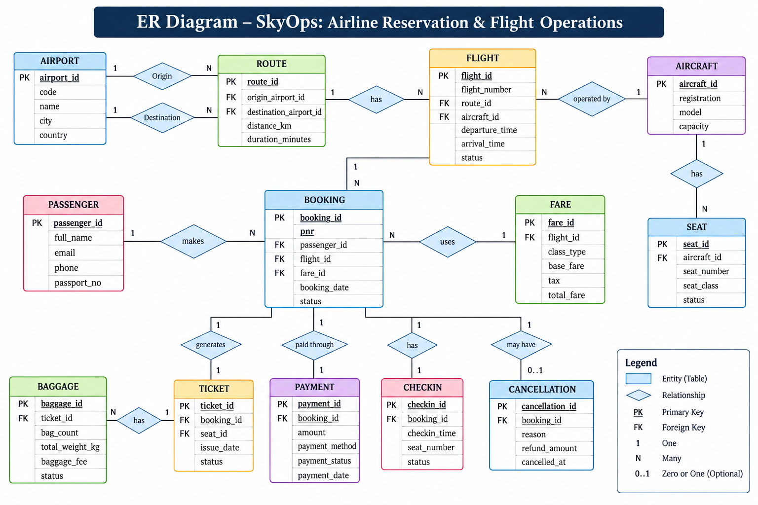
B · ER DIAGRAM & SCHEMA · ~2 MIN
ER Diagram
13 entities
one table per entity
Booking
central entity linking passenger, flight and fare
Cardinality
1:N relationships; cancellation is optional (0..1)
Keys
PK and FK marked on every entity
Notes:
Walk through Booking as the central entity, then flight side, then post-booking entities.

Slide 5
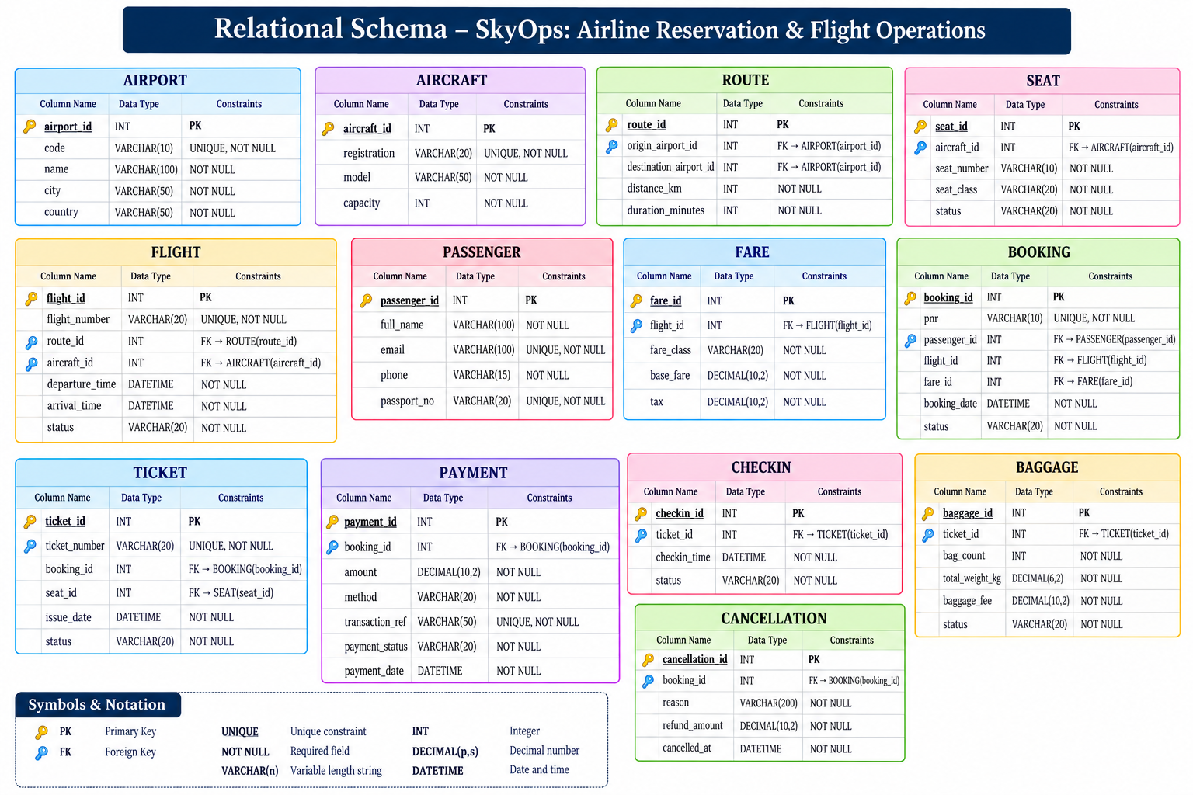
B · RELATIONAL SCHEMA
Relational Schema
ER → Tables → FDs → 1NF → 2NF → 3NF
1NF atomic attributes
2NF no partial dependencies
3NF no transitive dependencies
One table = one logical entity
PKs identify records uniquely
FKs maintain relationships
UNIQUE and NOT NULL on key attributes
Normalized up to 3NF to reduce redundancy and improve consistency.

Slide 6
B · NORMALIZATION
How 3NF Applies to airline_reservation
Table | Why it is separated
PASSENGER | Stores only passenger information
FLIGHT | Stores flight-specific information
AIRCRAFT | Stores aircraft details
AIRPORT | Stores airport details
BOOKING | Connects passenger with a flight
PAYMENT | Stores payment information for a booking
TICKET | Stores ticket and seat allocation
BAGGAGE | Stores baggage details for a ticket
REMOVING A TRANSITIVE DEPENDENCY
BEFORE NORMALIZATION
FLIGHT(flight_id, flight_number, aircraft_id, aircraft_model, aircraft_capacity)
aircraft_model and aircraft_capacity depend on aircraft_id, not directly on flight_id.
AFTER 3NF
FLIGHT(flight_id, flight_number, aircraft_id, ...)
AIRCRAFT(aircraft_id, registration, model, capacity)
Result Aircraft information is stored separately and referenced through aircraft_id, eliminating redundant data.

Slide 7
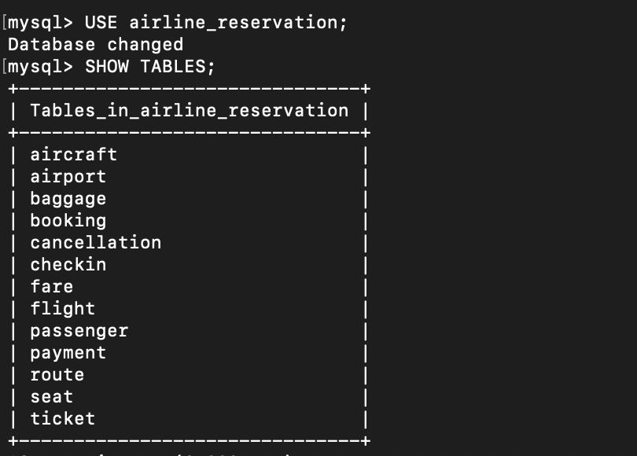
C · DATABASE & QUERIES · ~2 MIN
Database Implementation
PRIMARY KEY
unique record identification
FOREIGN KEY
referential integrity
UNIQUE
prevents duplicate values
NOT NULL
required information
CHECK
valid values / ranges
DEFAULT
sensible automatic values
MySQL: airline_reservation · 13 tables
BUSINESS RULES
aircraft · airport · baggage · booking · cancellation · checkin · fare · flight · passenger · payment · route · seat · ticket
One seat per passenger per flight
Aircraft capacity cannot be exceeded
Baggage weight cannot be negative
Check-in requires a confirmed booking
Cancellation / refund rules are enforced

Slide 8
C · SELECT, JOIN, AGGREGATES
SQL: From Data to Decisions
JOIN · passenger + booking + flight
FUNCTIONS
SELECT p.name, f.flight_id, b.booking_status
FROM booking b
JOIN passenger p ON b.passenger_id = p.passenger_id
JOIN flight f ON b.flight_id = f.flight_id;
COUNT()
SUM()
AVG()
REPORTS (via VIEWS)
AGGREGATE + GROUP BY · bookings per flight
Flight manifest
Flight occupancy
Route demand
Baggage
Cancellations
On-time status
Revenue
SELECT flight_id, COUNT(*) AS bookings
FROM booking GROUP BY flight_id;
NESTED QUERY · flights above a booking threshold
SELECT * FROM flight WHERE flight_id IN (
SELECT flight_id FROM booking
GROUP BY flight_id HAVING COUNT(*) > 2);
Illustrative patterns; replace with your exact queries before presenting.
SQL is used not only for storage, but for operational reporting.

Slide 9
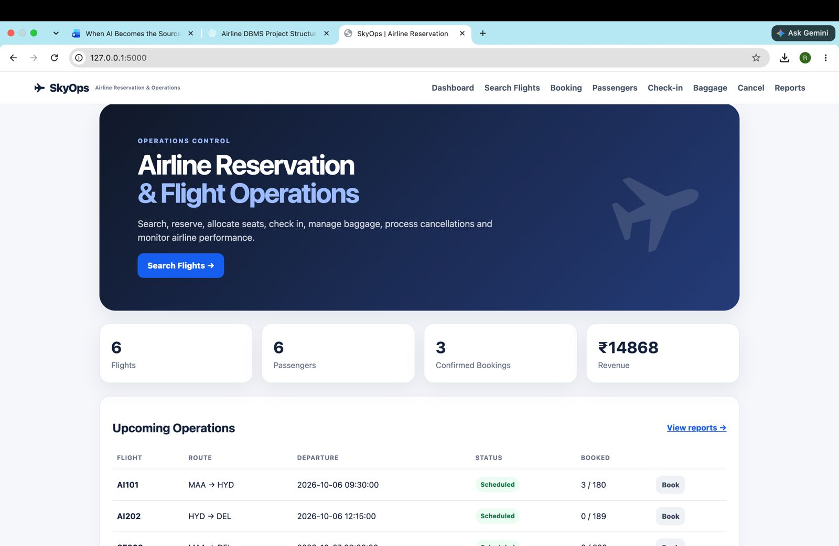
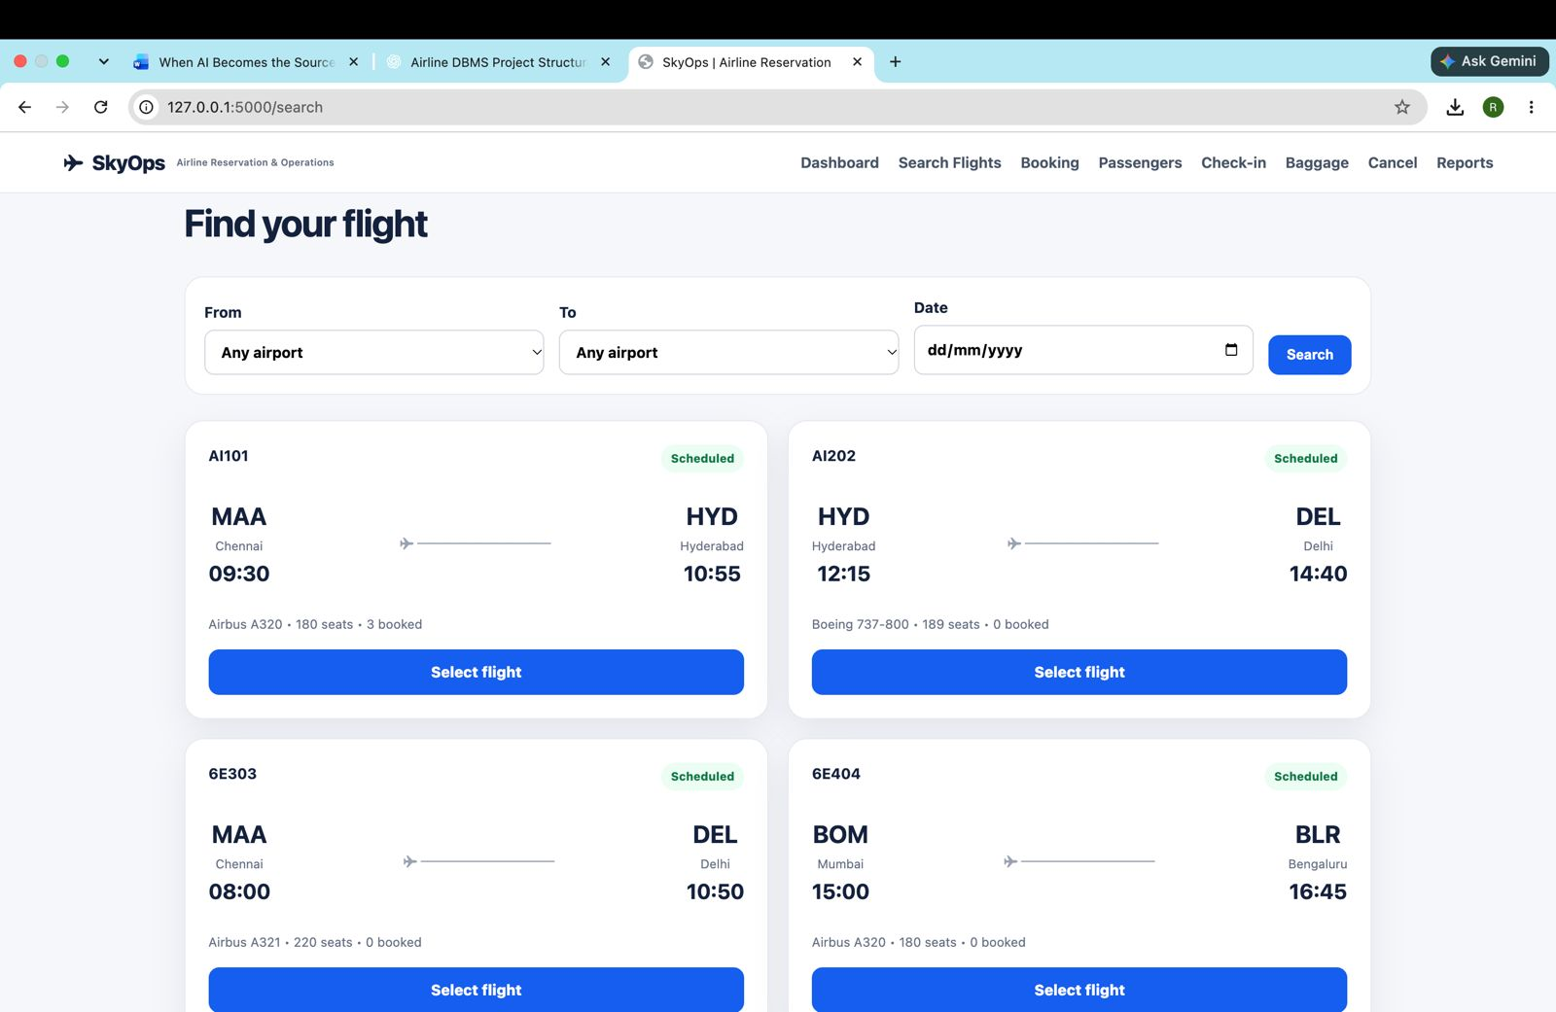
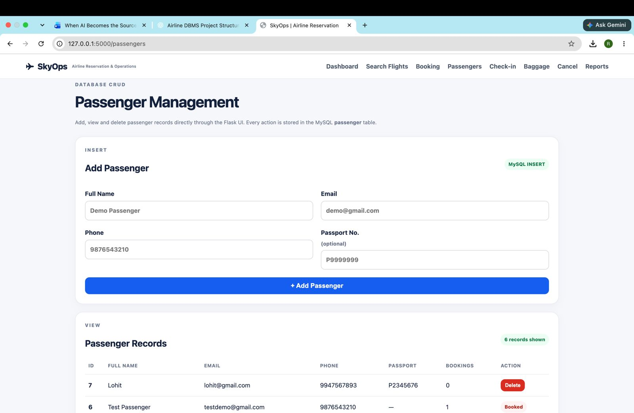
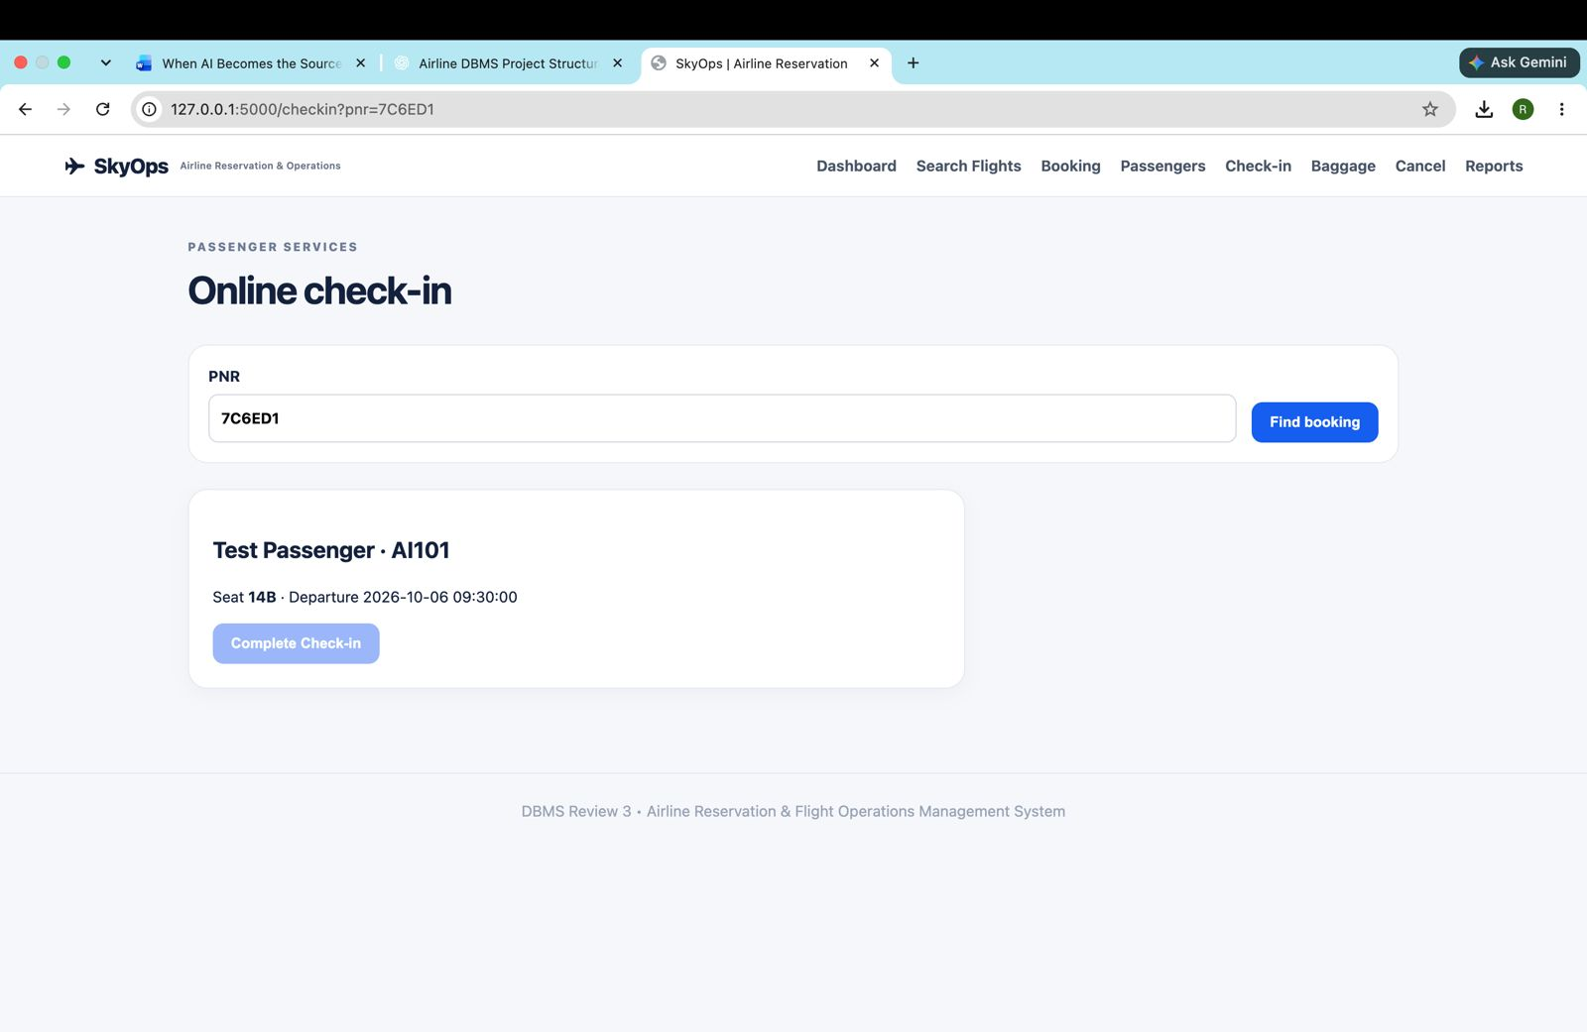
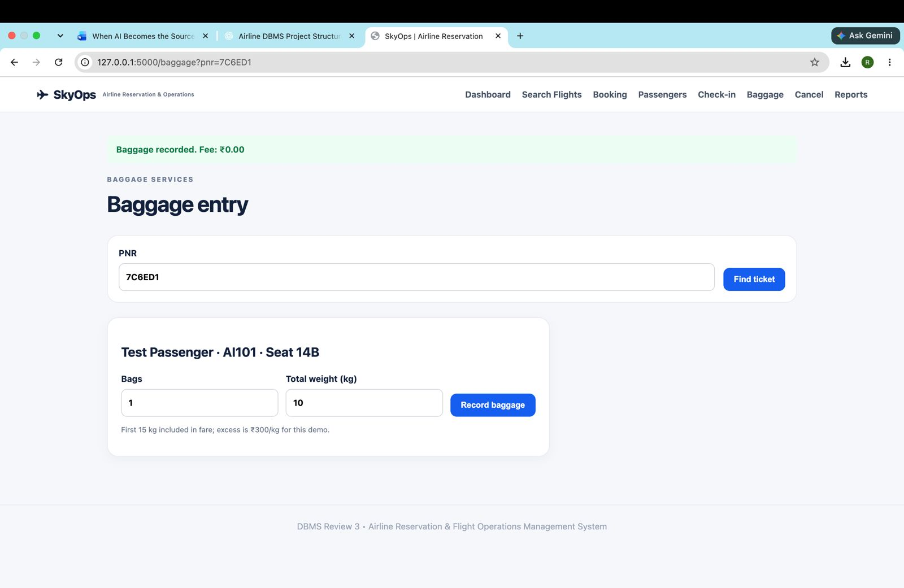
D · USER INTERFACE DEMO · ~3 MIN
SkyOps: Connected User Interface
Dashboard
Flight Search
Passenger Management
Flask UI ↔ MySQL
Every screen reads from or writes to the airline_reservation database.
Online Check-in
Baggage Entry

Slide 10
D · LIVE DEMONSTRATION
Database ↔ Application: Live Demonstration
USER ACTION
FLASK APPLICATION
MYSQL DATABASE
UPDATED RECORD
[ INSERT SELECT * FROM passenger; OUTPUT ]
Capture after the live insert/delete
1 · MySQL database / table structure
2 · UI operation: Passenger Management
3 · Updated database record
INSERT
Add passenger / booking
SELECT
View records
UPDATE
Modify information
DELETE
Remove permitted records

Slide 11
OUTCOME
Outcome & Key Takeaways
Designed a relational airline database
Populated tables with realistic data
Connected 13 major entities
Implemented joins, aggregates, nested queries and views
Converted the ER model to a relational schema
Connected MySQL with the SkyOps UI
Normalized up to 3NF
Search, booking, passengers, check-in, baggage
Applied integrity constraints
Demonstrated CRUD and database synchronization
“SkyOps connects database integrity with real airline operations through a single integrated system.”
Questions?
Notes:
Questions, ~2 min. Any member may be asked about any part.

